Slide 1

QR BASED 24X7 SMART ATM SYSTEM
TEAM MEMBERS:
Monisha.P (211417104152)
Nagiya Bhanu.G (211417104157)
Niranjana.B (211417104165)
GUIDE DETAILS:
Mrs.Vijayalakshmi.P
Associate Professor
BATCH NUMBER: 5

Slide 2

INTRODUCTION
With the development of computer network technology and e-commerce, the self-service banking system has got extensive popularization with the characteristic offering high-quality 24 hours service for customer.
Nowadays, using the ATM which provide customers with the convenient banknote trading is very common.
However, the financial crime case rises repeatedly in recent years, a lot of criminals tamper with the ATM terminal and steal user's credit card and password by illegal means.
Once user's bank card is lost and the password is stolen, the criminal will draw all cash in the shortest time, which will bring enormous financial losses to customer.
Our proposed concept for the ATM will simply use Quick Response Code and Biometric to withdraw their money within 30 sec. The generated QR Code will be scanned using Python.

Slide 3

LITERATURE SURVEY 1
Year of Publishing | Author Name | Title of the Paper | Merits | Demerits
2020 | B. Saranraj, N. Sri Priya Dharshini, R. Suvetha, K. Uma Bharathi | ATM Security System Using Arduino. | It has high security authentication The proposed framework gives high proficiency and maintains a strategic distance from illicit exchanges. | Some times fingerprint does not co-ordinate.
Link of Paper | https://ieeexplore.ieee.org/abstract/document/9074429

Slide 4
LITERATURE SURVEY 2
Year of Publishing | Author Name | Title of the Paper | Merits | Demerits
2020 | Gokul.S, Kukan.S, Meenakshi.K, Vishnu Priyan S S, Rolant Gini J, M.E.Harikumar | Biometric Based Smart ATM Using RFID. | Provides complete security as the face of the person accessing ATM card is recorded using camera with time and date. | Security can further be increased by using face detection, iris scanner, OTP generation.
Link of Paper | https://ieeexplore.ieee.org/document/9214287

Slide 5
LITERATURE SURVEY 3
Year of Publishing | Author Name | Title of the Paper | Merits | Demerits
2020 | Arju Aman, Aryan Singh, Ayush Raj Sandeep Raj | An Efficient Bar/QR Code Recognition System for Consumer Service Applications. | It takes less than 0-30 seconds to distinguish barcode. It takes less time to compute. | In captured image we have many noises which can’t be removed. Selects the pixels with high gradient.
Link of Paper | https://ieeexplore.ieee.org/abstract/document/916177

Slide 6
PROBLEM STATEMENT
One big fear during COVID-19 has been associated with the use of ATM.
To ensure that the entire process of withdrawing cash from ATM is completed without touching the machine or the screen is looking possible now.
ATM cardholders can now withdraw cash from an ATM by scanning a QR code on the mobile phone by ATM machine’s screen without having to touch the surface.
And along with that ATM Card has complications with validation and transmission process.
Therefore, by using peeping attack, the secret code was stolen while entering PIN at the ATM machine.
So the data of a user is to be ensured that secure and isolated from the data leakage and other attacks.

Slide 7

TECHNOLOGY STACK
Hardware Requirements
Display : LCD Display
Device : Fingerprint Device, Relay
Software Requirements
Language : Python, Embedded C, Arduino IDLE
Application : Android Studio

Slide 8
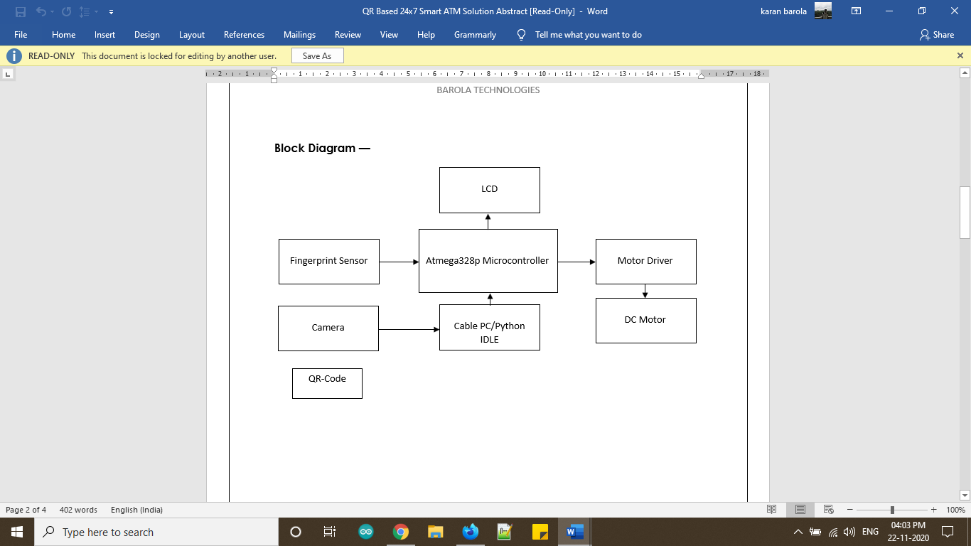


SYSTEM ARCHITECTURE

Slide 9
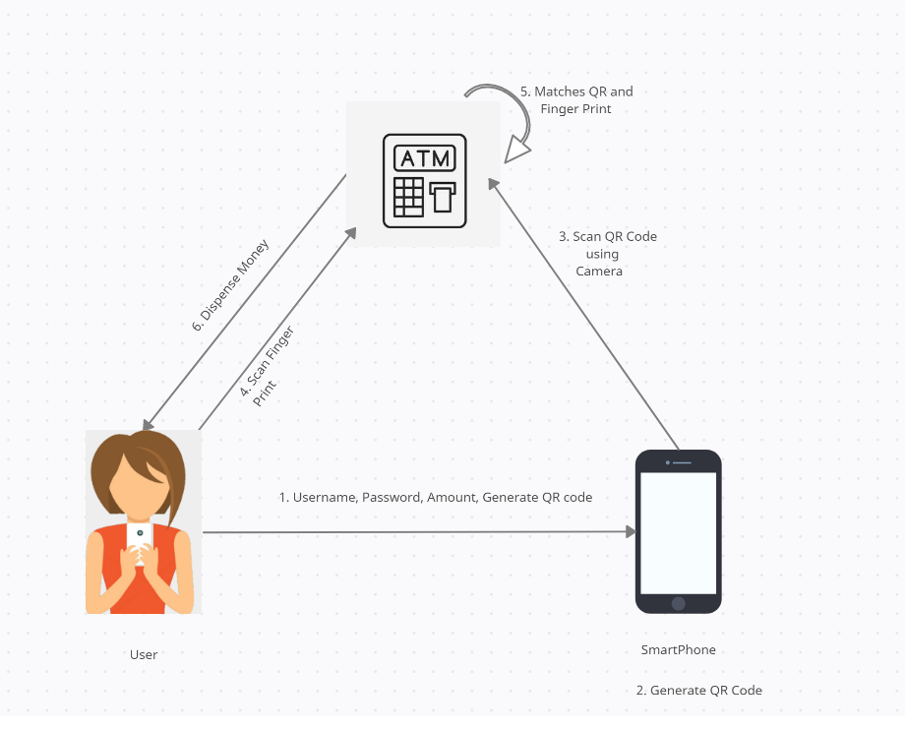
SYSTEM DESIGN

Slide 10
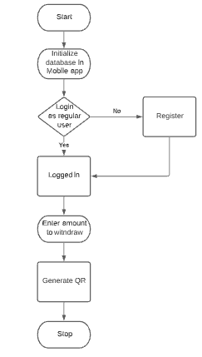
PROCESS FLOW
PROCESS IN MOBILE APP:

Slide 11
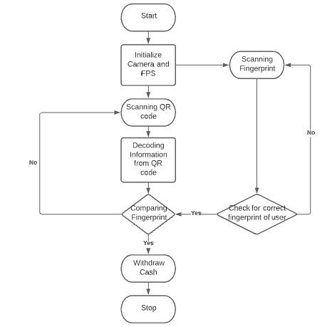
HARDWARE PROCESS:

Slide 12
MODULE DESCRIPTION
Integration of Hardware
Implementation of Software:
Design & Development of Android Application
Programming

Slide 13
INTEGRATION OF HARDWARE
Integration of Arduino Microcontroller to Lcd Display.
Integration of Fingerprint Sensor for Biometric Solution which stores fingerprint in the sensor model.
Connecting Motor with Driver board to preview the Dispensing Method.
Connecting Power Supply to the hardware kit.

Slide 14
IMPLEMENTATION OF SOFTWARE - DESIGN & DEVELOPMENT OF ANDROID APPLICATION
Android Studio is used in to create the Application.
Mobile Appilcation will have a Login Page where user can Register/Login.
If the user is new the user can Register by using their Mobile number, email id and password for first time.
And if the user is regular, then they can Login using their Email id and Password. Then they can enter the amount to be withdrawn.
By clicking Generate QR code a QR code will be generated.

Slide 15
IMPLEMENTATION OF SOFTWARE - PROGRAMMING
Programming language used are Python and Embedded C
Python is for generating QR code, read the QR code from the App and to send the serial data to the microcontroller.
QR code is generated using Google ZXing Package.
Embedded C is used to writing and uploading programs to Arudino compatible boards.
Comparing the QR code and Fingerprint is done using Verification module. If matches then motor rotates which means the 2-step authentication is completed successfully and Money will be dispensed.

Slide 16
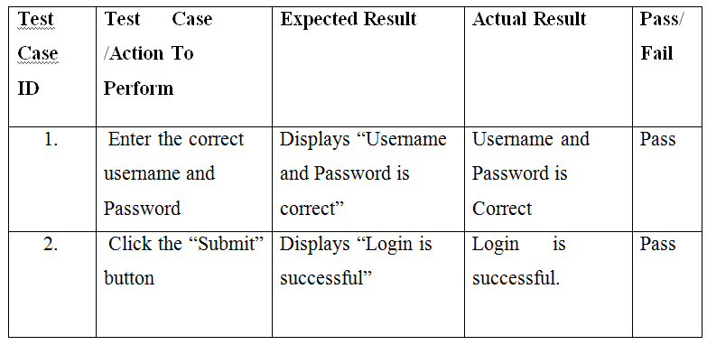

PERFORMANCE OF EVALUATION
TEST REPORT 1
PRODUCT : QR Based 24x7 Smart ATM System
LOGIN DETAILS

Slide 17
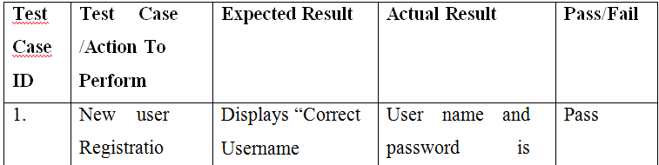
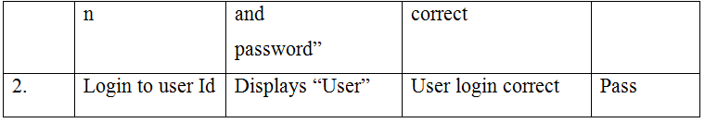
TEST REPORT 2
PRODUCT : QR Based 24x7 Smart ATM System
NEW USER REGISTRATION

Slide 18
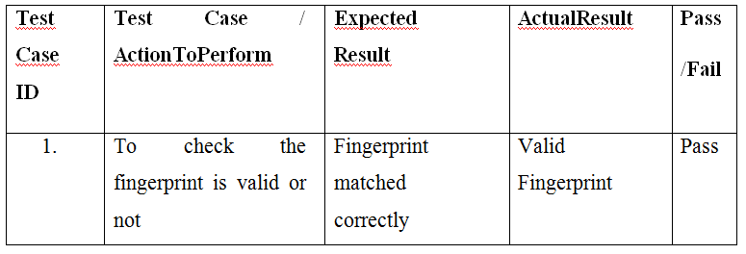
TEST REPORT 3
PRODUCT : QR Based 24x7 Smart ATM System
FINGERPRINT VERIFICATION

Slide 19
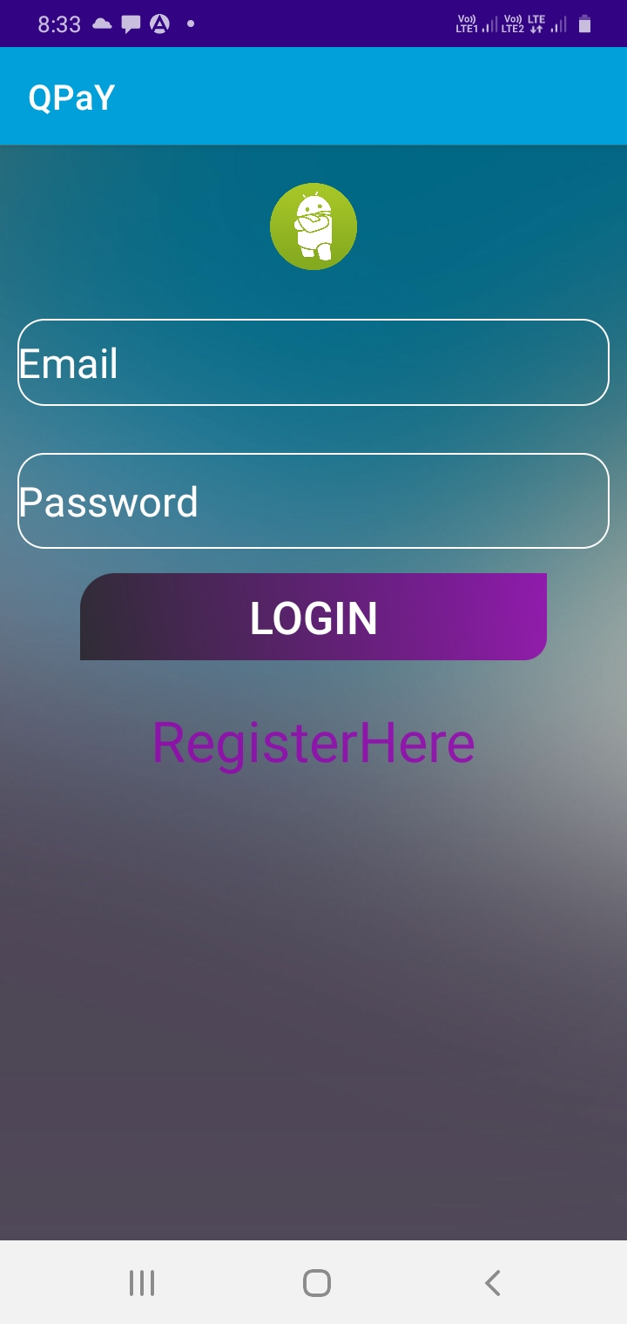

SCREEN SHOTS

Slide 20
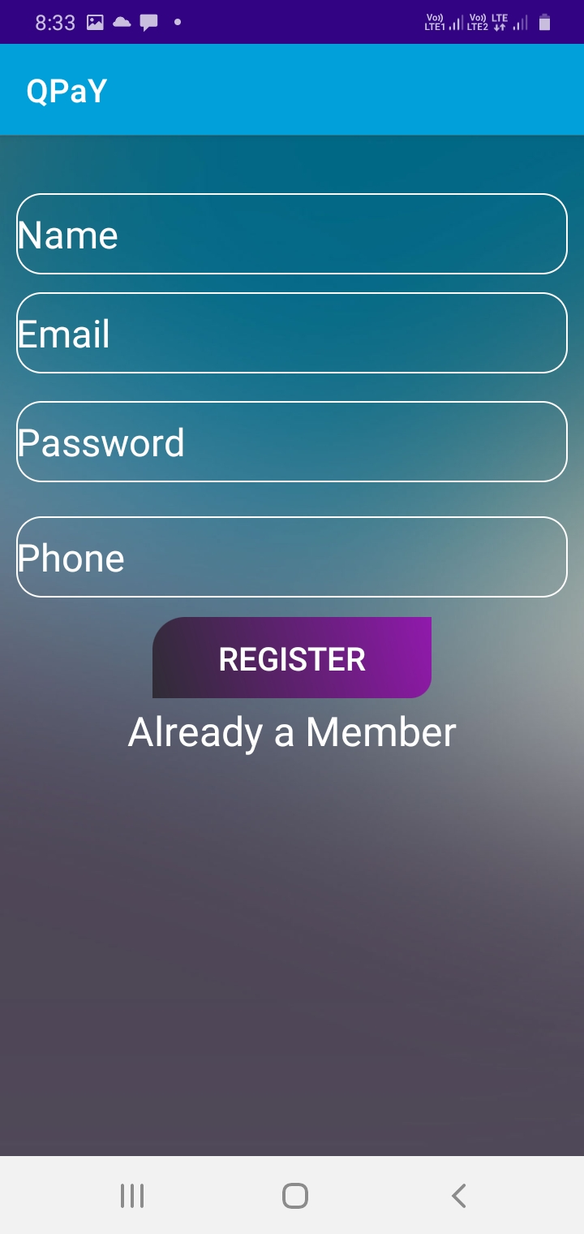

Slide 21
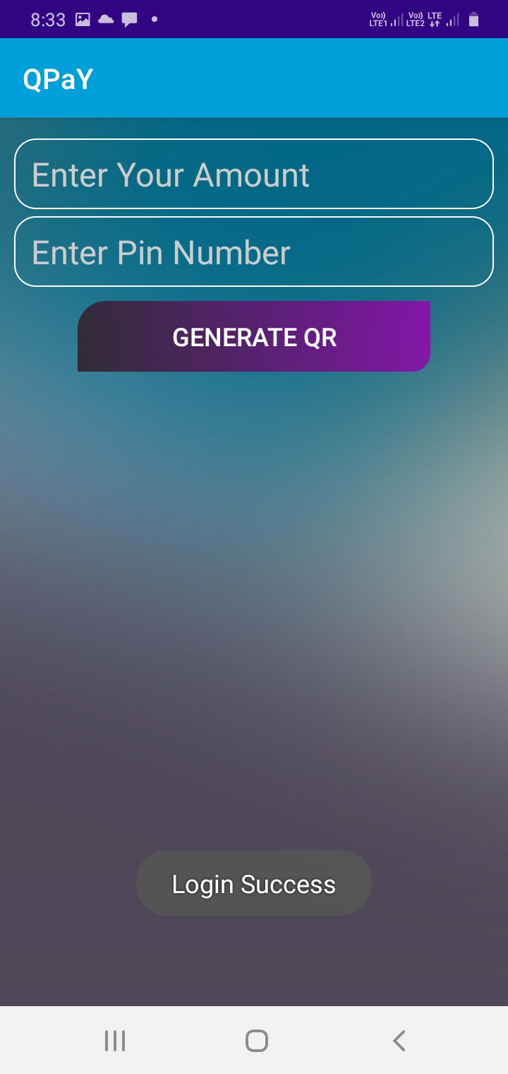

Slide 22
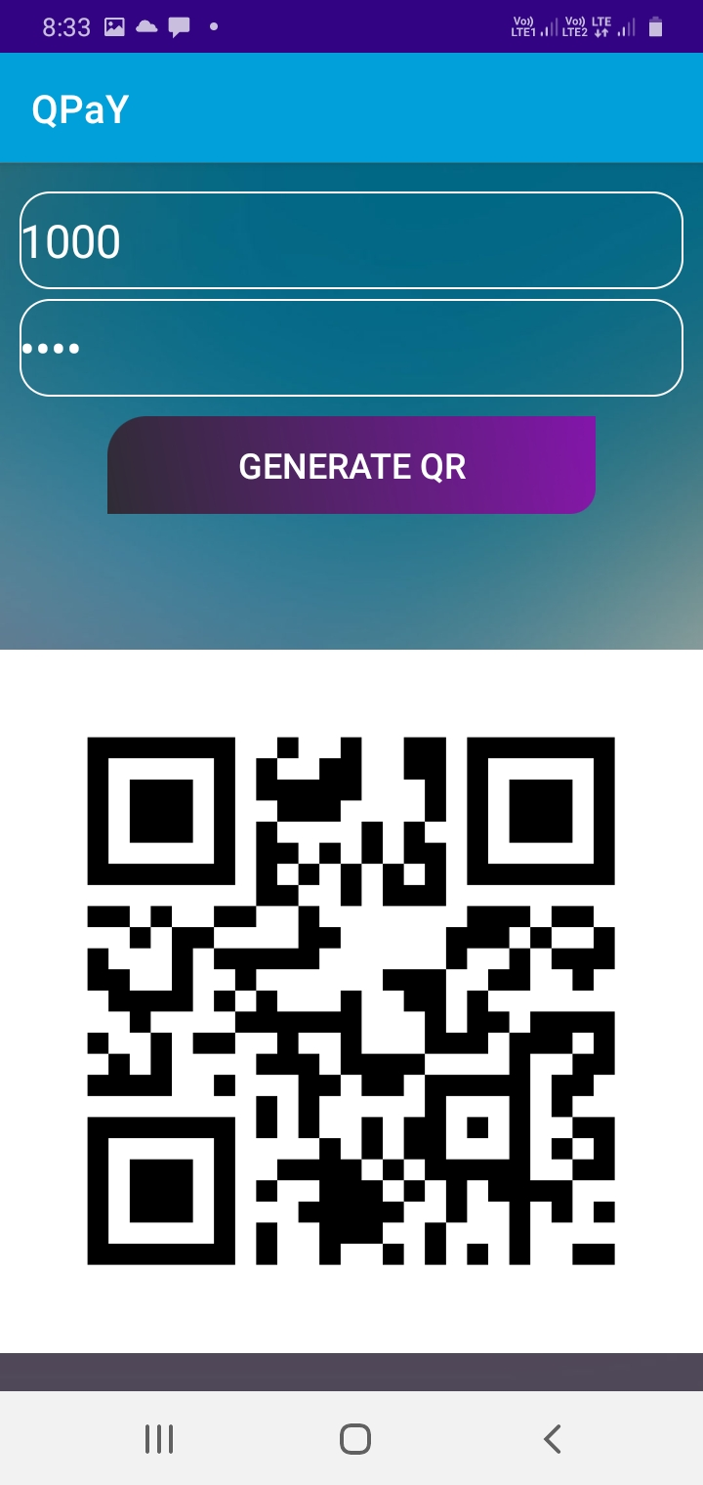

Slide 23
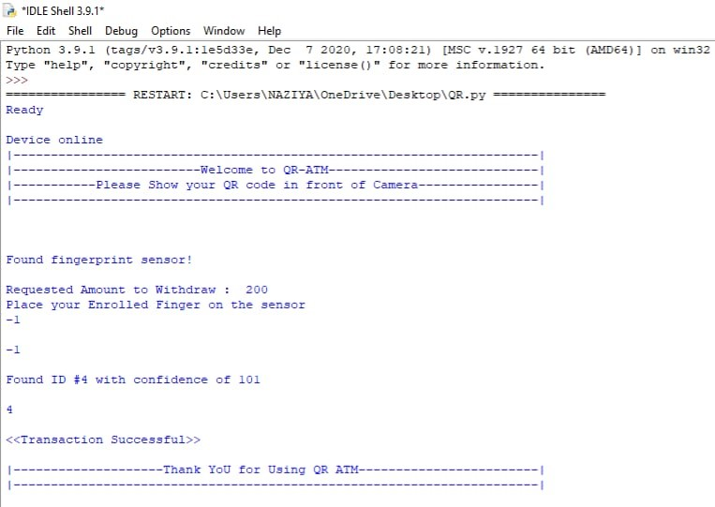


Slide 24
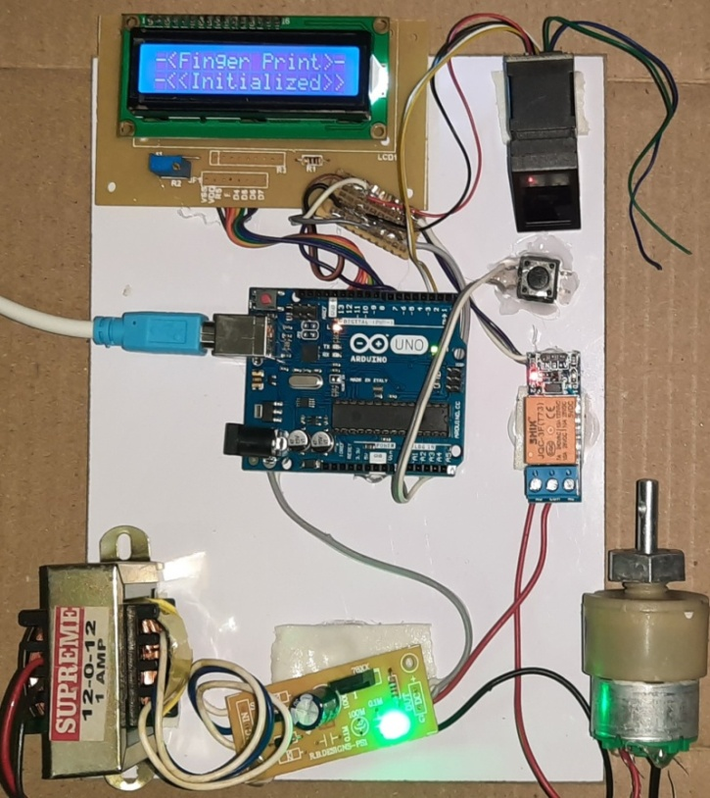


Slide 25
CONCLUSION
The design of this ATM system based on QR code and fingerprint recognition has advantages of the stability and reliability of fingerprint characteristics.
The system also Reduces Contact based use (very useful in the times like covid-19).
And it is more Secured as Only Authorized person can use the Card as we have multilevel Authentication.
This system will also be Suitable for people who have very less knowledge to use Atm(s).

Slide 26
REFERENCES
[1] onyesolu. m. o and ezeani. i. m, “ATM security using fingerprint biometric identifier: an investigative study”, international journal of advanced computer science and applications 2012.
[2] renee jebaline. g, gomathi. s, “a novel method to enhance the security of ATM using biometrics”, international conference on circuit, power and computing technologies 2015.
[3] Sweta singh, akhilesh singh, rakesh kumar,“a constraint based biometric scheme on ATM and swiping”, international conference on computational techniques in information and communication technologies (icctict) 2016.
[4] T. R. Tuinstra, “Reading barcodes from digital imagery,” Ph.D. dissertation, Cedarville University, 2006.
[5] E. Tekin and J. M. Coughlan, “An algorithm enabling blind users to find and read barcodes,” in Applications of Computer Vision (WACV), 2009 Workshop on, 2009.
[6] X. Q. James Juett, “Barcode localization using bottom-hat filter,” NSF Research Experience for Undergraduates, 2005.
[7] Jun Zhou, Guangda Sua, Chun hongJiang. “A face and fingerprint identity authentication system based on multi-route detection”. Neurocomputing 70 (2007) pp. 922-931.
[8] Yuliang He, Jie Tian, Xiping Luo, Tanghui Zhang. “Image enhancement and minutiae matching in fingerprint verification”. Pattern Recognition Letters 24 (2003) pp.1349-1360.
[9] Wei Wang, Jianwei Li, Feifei Huang, Hailiang Feng. “Design and implementation of Log-Gabor filter in fingerprint image enhancement”. Pattern Recognition Letters 29 (2008) pp. 301-308.
[10] Arju Aman,Aryan Singh,Ayush Raj and Sandeep Raj. “An Efficient Bar/QR code recognition system for consumer service applications”. Pattern recognition letters 2020.

Slide 27
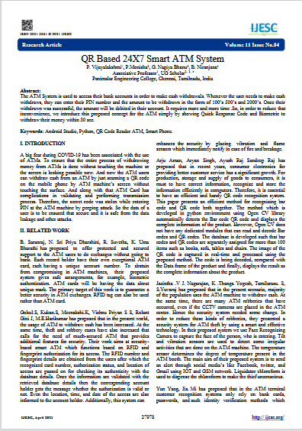
PUBLICATION DETAILS
Paper Title : QR Based 24X7 Smart ATM System
Journal Name : International Journal of Engineering Science and Computing (IJESC)
Publication Issue : Volume 11, Issue No.04, April 2021
Page Numbers : 27978, 27979, 27980
Link : https://ijesc.org/upload/a31d1b97f30c9afaeee19924b30b5296.QR%20Based%2024X7%20Smart%20ATM%20System-converted.pdf

Slide 28

Any Questions?

